Slide 1
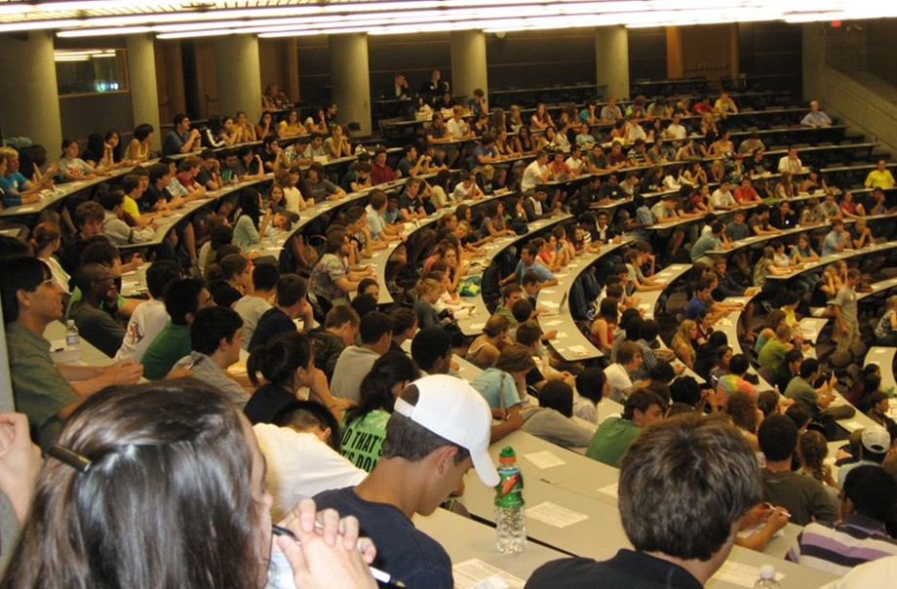
Transformed for UM’s Third Century
Provost’s Seminar on Teaching
Tim McKay
REBUILD Project Principal Investigator

Slide 2
A little history
NSF WIDER program: promotes evidence based teaching
REBUILD grant received in summer 2013: Physics, Chemistry, both Biologies, Math
Three years of work to explore reform of big intro STEM courses
Elements of REBUILD
Faculty committee – exploring research and advocating for change
Two years of colloquia in every dept & 2 PSOTs
Multigenerational teams: five teaching postdocs
Strong analytic support
Various outcomes across departments

Slide 3
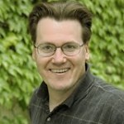
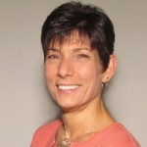
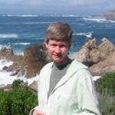
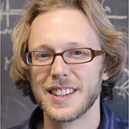
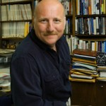
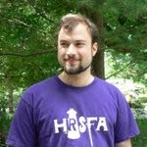
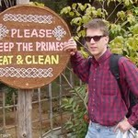
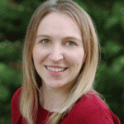
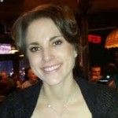
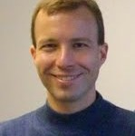
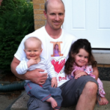
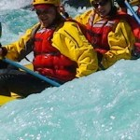
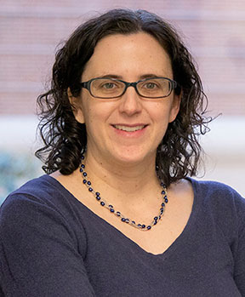
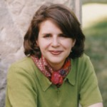
Department of Physics
Colloquium Presentation
October 15, 2014

Slide 4
The REBUILD process taught us…
Excellence exists in many pockets
Courses taught by dedicated, stable teams: Chemistry, Math, English, Statistics
Maintained by sustained, substantial commitment from individual faculty & staff, departments, and the college
We’re not institutionally arranged to encourage and support reform
Heroic evidence-based reforms strain the system: Bio 171/173, Physics 140/240, Astro courses
External funding (HHMI & more) can get things started, but doesn’t last

Slide 5
Teaching in teams
Best large courses taught in multigenerational teams with role specialization
These mirror research teams: faculty, lecturers staff, postdocs, grad students, undergrads
Roles include: course management, preparation and design, delivery of instruction in large and small groups, technology support, student study groups, honors enrichment, supplemental instruction, assessment
Teams stable in roles & structure, rather than individuals

Slide 6
How to build on REBUILD?
How to get to a place where top quality large courses are the norm?
REBUILD began working w/CRLT on this last winter
Met with faculty and staff who work on these courses in focus groups on what they need, department chairs across STEM
Also met with student groups: their input is important & informative!
Today: Provost’s Seminar on Teaching
What a reformed course might be, and how we might get there
Considering paths to transformation driven by:
Data
Inclusion
Pedagogy
Technology

Slide 7
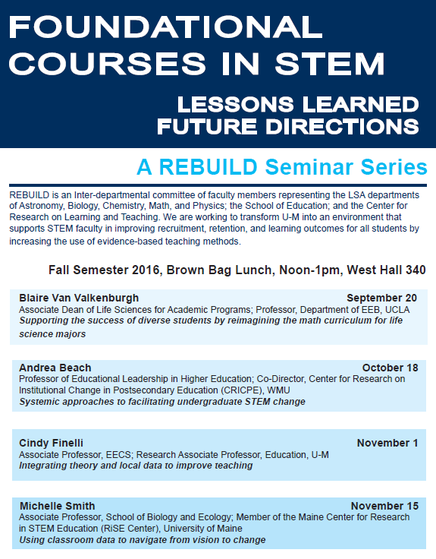
REBUILD Seminar Series During the 2016/17 academic year we’re exploring how other institutions have implemented new support structures for foundational courses.

Slide 8
9,200 Courses at Michigan
The vast majority are handmade, artisanal
Small & changeable
Taught in idiosyncratic, engaged, and creative ways
Faculty members whose research expertise influences both course content and their pedagogical approach
Some (1-2% of the list) are manufactured
Large & relatively stable
Taught in industrial, remote, and tradition bound ways
Often far from the research expertise of instructors, which influences neither content nor pedagogy
Most courses on campus already have what they need to be excellent.
Large foundational courses are different: they could be dramatically better with more and different forms of support.

Slide 9
Students encounter foundational courses in many ways
As central prerequisites considered essential for further study in a discipline
As a first encounter with hands-on lab, studio, or performance work
As opportunities to discover unimagined areas for concentration
As one-time visits to disciplines focused on distribution
As courses intended to build skills for use in other disciplines

Slide 10
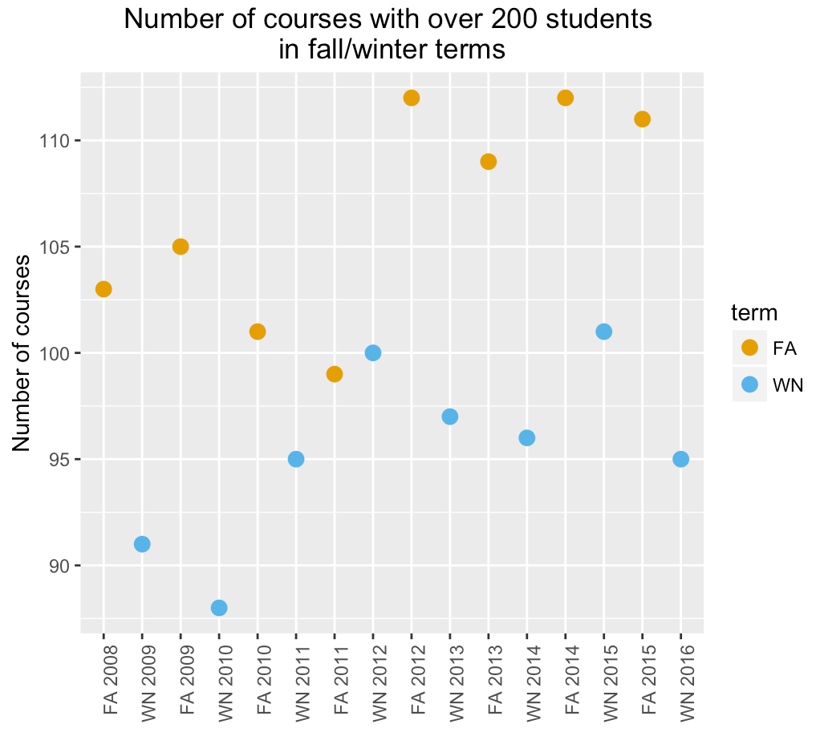
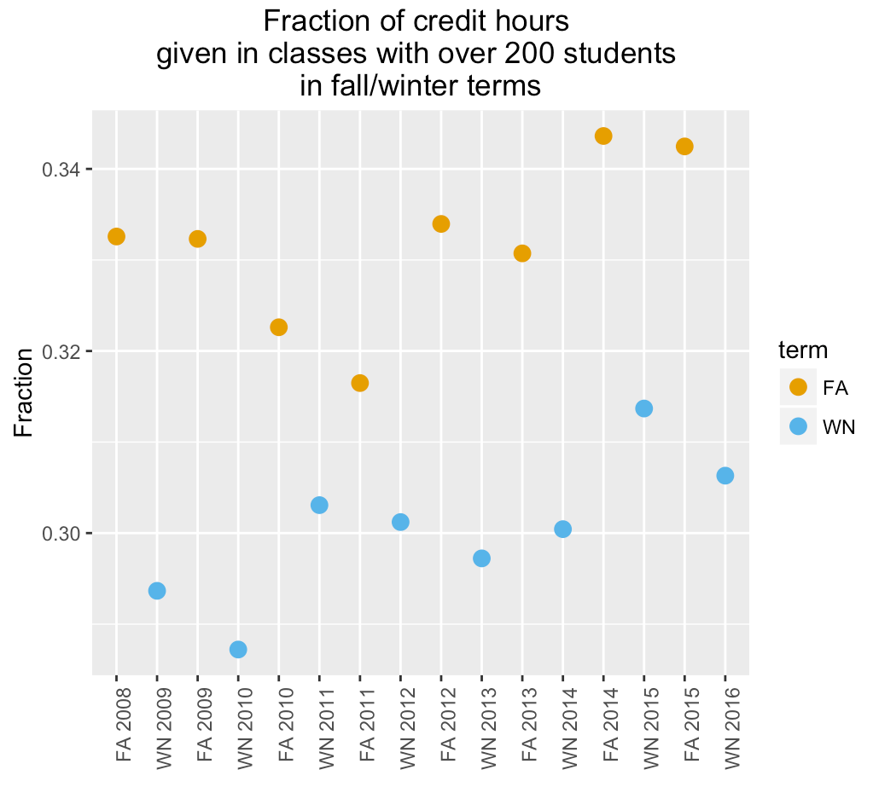
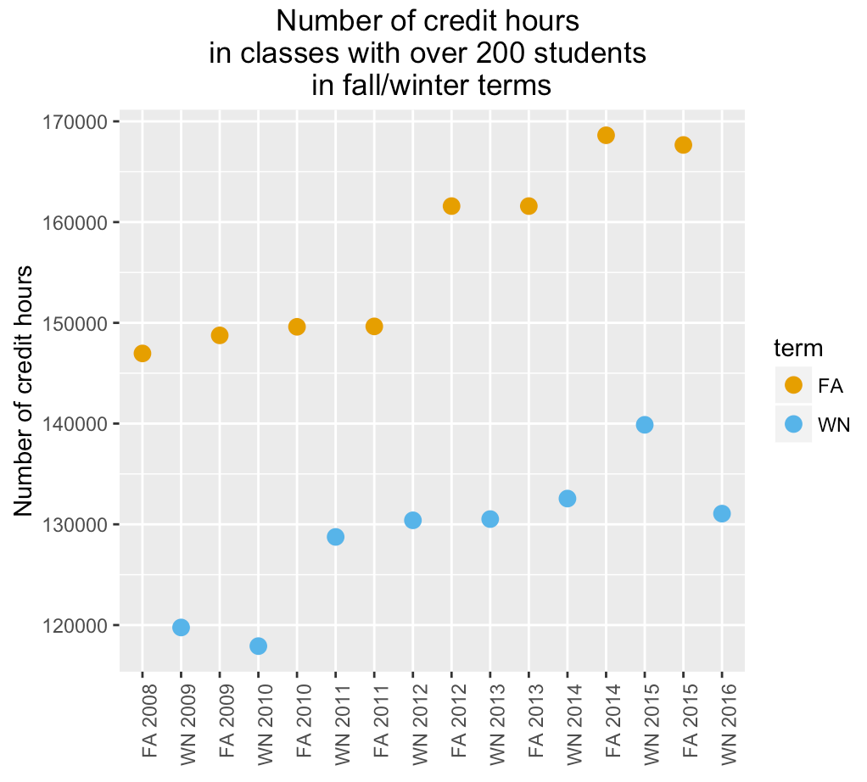
Foundational courses are important
Students pay more than $150 million in tuition for these foundational courses every term!

Slide 11
A Foundational Course Initiative
REBUILD collaborating with CRLT on a proposal for next generation support of a new category of ‘Foundational Courses’
Ask for renewed commitment from departments, offer unprecedented forms of support
Apply the ‘Foundational’ label to courses when these new commitments and support is in place
Students considering large courses should begin to seek courses labeled in this way…

Slide 12
What makes a course foundational?
Most of the course’s home department shares a slowly evolving understanding of course goals
This sense will often be shared by the discipline more broadly.
Could be lecture, lab, etc.
The course is offered very regularly. Usually it will have a long history of regular offerings.
The course has large enrollments.
The course serves students with especially various backgrounds.
The course serves students with especially various interests and goals.
The course regularly changes instructors, and is often taught by a team of faculty and lecturers
We believe ‘foundational’ courses exist across many disciplines, most of which are outside the natural sciences, and intend this initiative to be campus-wide.

Slide 13
Why now? An unusual opportunity
Convergence creates a chance for us to get the reform we want
UM’s Third Century
UM’s Academic Innovation Initiative
National conversation, AAU STEM Initiative
Important, visible role of large courses at Michigan
Teaching in an information age enables something new
Technology supports tools which help us teach at scale
Research suggests ways courses might be improved
Data provide strong ways to test what we try

Slide 14
What can you do?
Attend today’s PSOT and contribute your ideas
Begin thinking about courses which might be well-served by foundational support
Keep track of support needs which would be most valuable for you and your students, and of reform ideas from here and elsewhere
Consider attending REBUILD seminars on transforming teaching this year & pitching in

